Slide 1
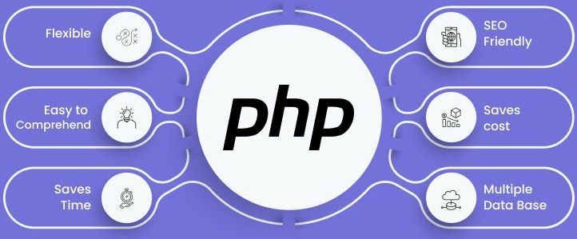

Slide 2
About today…
Arrays
Introduction
Indexed arrays
Associative arrays

Slide 3

ARRAYS

Slide 4
Intro to Arrays
Definition
Arrays in PHP are variables that can hold multiple values
Allows to store and access a collection of data elements under a single variable name
Purpose
Help in organizing and managing data efficiently
especially when dealing with multiple related values

Slide 5


Indexed Arrays
Definition
Arrays where each element is assigned a numeric index starting from 0
Syntax
Example

Slide 6

Accessing elements in Indexed Arrays
By Index
Elements in indexed arrays are accessed using their numeric index
Example

Slide 7


Modifying/Adding Elements in Indexed Arrays
Modifying
Adding

Slide 8
Associative Arrays
Definition
Arrays where each element is associated with a specific key
Syntax
Example

Slide 9

Accessing elements in Associative Arrays
By Key
Elements in associative arrays are accessed using their corresponding keys.
Example

Slide 10


Modifying/Adding Elements in Associative Arrays
Modifying
Adding

Slide 11


Slide 12


What is the key difference between indexed arrays and associative arrays in PHP?
How do you access an element in an indexed array with the index 2
What is the output of the following code?

Slide 13

Task 1
Create an indexed array named $numbers containing the numbers 10, 20, 30, and 40.
Then, echo the element at index 2
Task 2
Create an associative array named $person with keys "name", "age", and "city" and corresponding values "Alice", 30, and "London".
Modify the value associated with the "age" key to 35 and add a new key-value pair "country" => "UK"
Task 3
Create an array named $fruits containing the fruits "Apple", "Banana", "Orange", and "Mango".
Use the count() function to determine the number of elements in the array and echo the result.

